Slide 1
Department of Applied Mathematics and Computational Sciences
III Sem M.Sc.Software Systems
Transform Techniques
Dr. V. Suresh kumar

Slide 2
Derivative of Transform

Slide 3
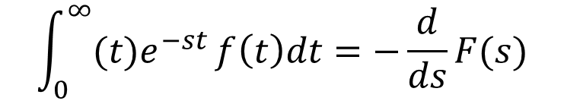
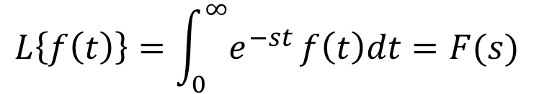
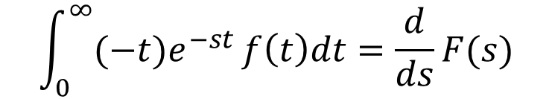
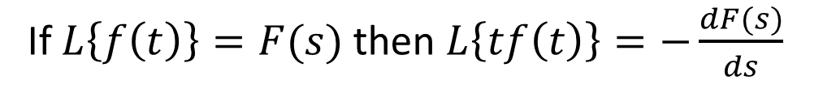
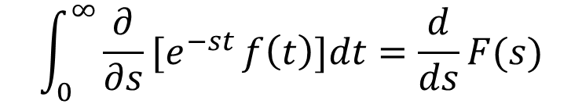
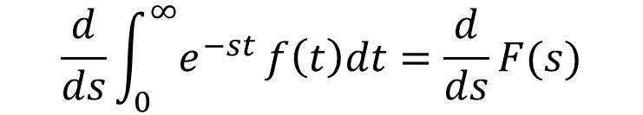
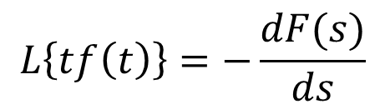

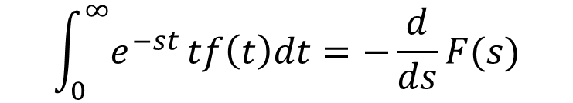
Statement
If $L\left\{f\left(t\right)\right\}=F(s)$ then $L\left\{tf\left(t\right)\right\}=−\frac{dF(s)}{ds}$
Proof:
We have
$$\int_{0}^{∞}{{(−t)e}^{−st}}f\left(t\right)dt=\frac{d}{ds}F(s)$$
$$L\left\{f\left(t\right)\right\}=\int_{0}^{∞}{e^{−st}}f\left(t\right)dt=F(s)$$
$$\int_{0}^{∞}{{(t)e}^{−st}}f\left(t\right)dt=−\frac{d}{ds}F(s)$$
Differentiate on both sides w.r.t $s$
$$\frac{d}{ds}\int_{0}^{∞}{e^{−st}}f\left(t\right)dt=\frac{d}{ds}F(s)$$
$$\int_{0}^{∞}{e^{−st}}tf\left(t\right)dt=−\frac{d}{ds}F(s)$$
$$\int_{0}^{∞}{{\frac{∂}{∂s}[e}^{−st}}f\left(t\right)]dt=\frac{d}{ds}F(s)$$
$$L\left\{tf\left(t\right)\right\}=−\frac{dF(s)}{ds}$$

Slide 4

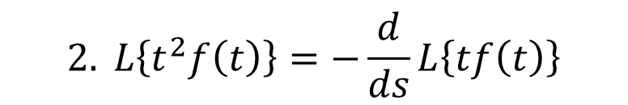


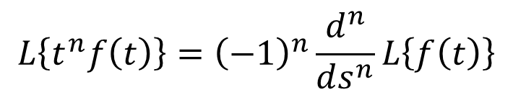
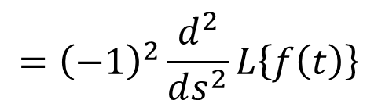
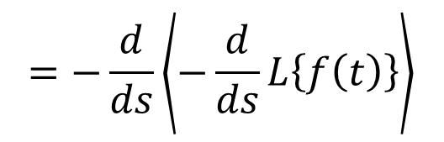

Note
$$1. L\left\{tf\left(t\right)\right\}=−F′(s)$$
$$3. L^{−1}\left[F′(s)\right]=−tf\left(t\right)$$
$$2. L\left\{t^{2}f\left(t\right)\right\}=−\frac{d}{ds}L\left\{tf\left(t\right)\right\}$$
$$=−tL^{−1}[F\left(s\right)]$$
$$=−\frac{d}{ds}\left\langle −\frac{d}{ds}L\left\{f\left(t\right)\right\}\right\rangle$$
$$L^{−1}\left[F′(s)\right]=−tL^{−1}[F\left(s\right)]$$
$$={\left(−1\right)}^{2}\frac{d^{2}}{ds^{2}}L\left\{f\left(t\right)\right\}$$
Similarly
$$L\left\{t^{n}f\left(t\right)\right\}={\left(−1\right)}^{n}\frac{d^{n}}{ds^{n}}L\left\{f\left(t\right)\right\}$$

Slide 5
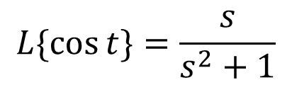
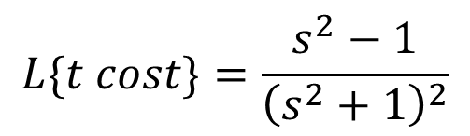
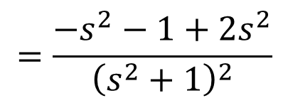
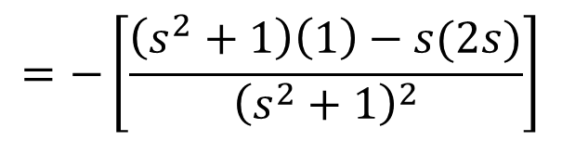
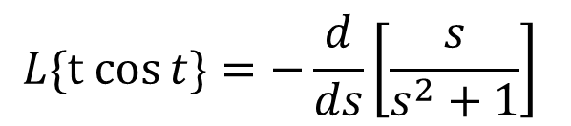
Example Problems
1. Find the Laplace Transform of $f\left(t\right)=t\cos{t}$
Ans:
We have
$$L\{\cos{t\}=\frac{s}{s^{2}+1}}$$
$$L\{t cos{t\}=−\frac{d}{ds}\left[\frac{s}{s^{2}+1}\right] }$$
$$L\{t cost\}=\frac{s^{2}−1}{{\left(s^{2}+1\right)}^{2}}$$
$$=−\left[\frac{\left(s^{2}+1\right)\left(1\right)−s(2s)}{{\left(s^{2}+1\right)}^{2}}\right]$$
$$=\frac{−s^{2}−1+2s^{2}}{{\left(s^{2}+1\right)}^{2}}$$

Slide 6
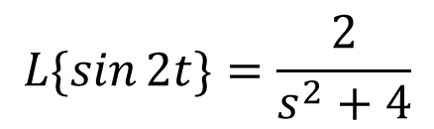
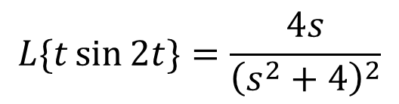
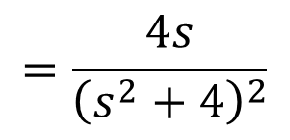
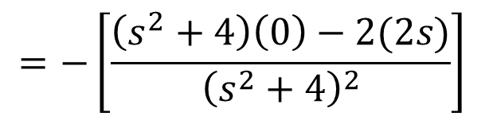
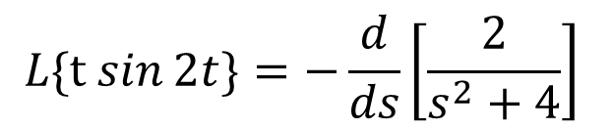
Problems Cont…
2. Find the Laplace Transform of $f\left(t\right)=t\sin{2t}$
Ans:
We have
$$L\{\sin{2t\}=\frac{2}{s^{2}+4}}$$
$$L\{t sin{2t\}=−\frac{d}{ds}\left[\frac{2}{s^{2}+4}\right] }$$
$$L\{t\sin{2t\}}=\frac{4s}{{\left(s^{2}+4\right)}^{2}}$$
$$=−\left[\frac{\left(s^{2}+4\right)\left(0\right)−2(2s)}{{\left(s^{2}+4\right)}^{2}}\right]$$
$$=\frac{4s}{{\left(s^{2}+4\right)}^{2}}$$

Slide 7
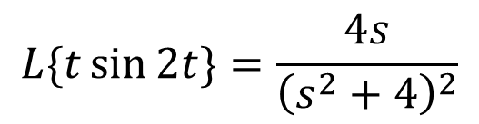
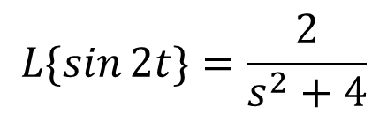
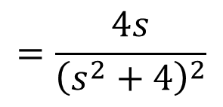
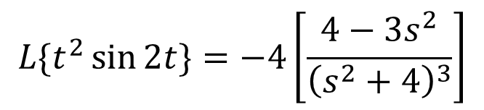
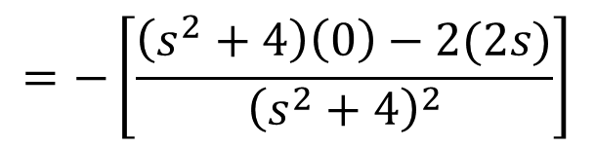
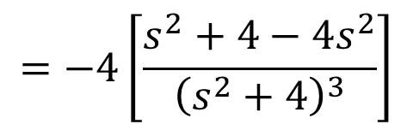
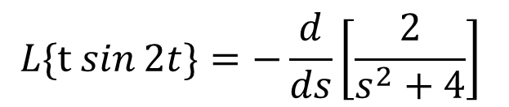
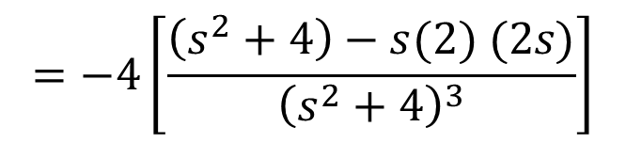
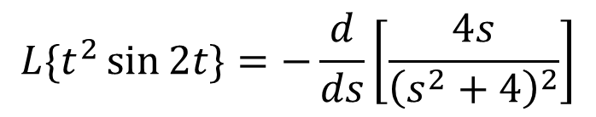
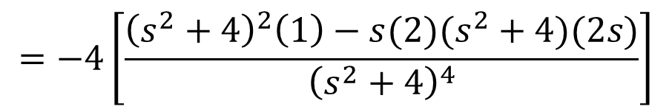
Problems Cont…
3. Find the Laplace Transform of $f\left(t\right)=t^{2}\sin{2t}$
Ans:
$$L\{t^{2}\sin{2t\}}=−\frac{d}{ds}\left[\frac{4s}{{\left(s^{2}+4\right)}^{2}}\right]$$
We have
$$L\{\sin{2t\}=\frac{2}{s^{2}+4}}$$
$$=−4\left[\frac{{\left(s^{2}+4\right)}^{2}\left(1\right)−s(2)(s^{2}+4)(2s)}{{\left(s^{2}+4\right)}^{4}}\right]$$
$$L\{t sin{2t\}=−\frac{d}{ds}\left[\frac{2}{s^{2}+4}\right] }$$
$$=−4\left[\frac{\left(s^{2}+4\right)−s(2) (2s)}{{\left(s^{2}+4\right)}^{3}}\right]$$
$$=−\left[\frac{\left(s^{2}+4\right)\left(0\right)−2(2s)}{{\left(s^{2}+4\right)}^{2}}\right]$$
$$=−4\left[\frac{s^{2}+4−4s^{2}}{{\left(s^{2}+4\right)}^{3}}\right]$$
$$=\frac{4s}{{\left(s^{2}+4\right)}^{2}}$$
$$L\{t^{2}\sin{2t\}}=−4\left[\frac{4−3s^{2}}{{\left(s^{2}+4\right)}^{3}}\right]$$
$$L\{t\sin{2t\}}=\frac{4s}{{\left(s^{2}+4\right)}^{2}}$$

Slide 8
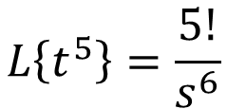
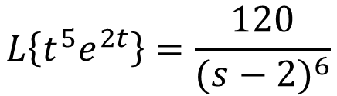
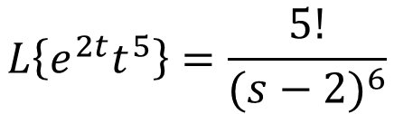
Problems Cont…
4. Find the Laplace Transform of $f\left(t\right)=t^{5}e^{2t}$
Ans:
We have
$$L\left\{t^{5}\right\}=\frac{5!}{s^{6}}$$
$$L\left\{{e^{2t}t}^{5}\right\}=\frac{5!}{{(s−2)}^{6}}$$
$$L\left\{t^{5}e^{2t}\right\}=\frac{120}{{(s−2)}^{6}}$$

Slide 9
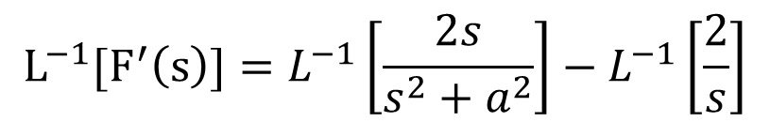
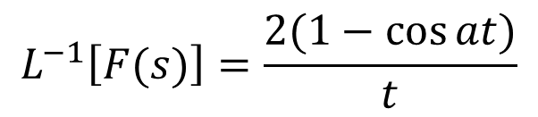
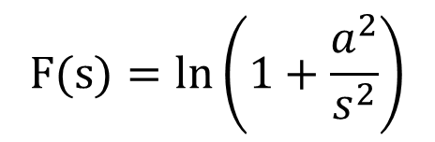

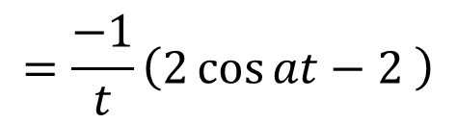

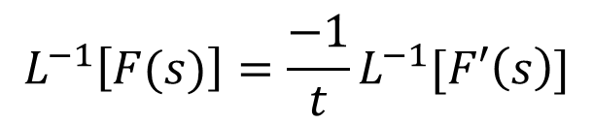


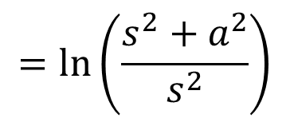

Problems Cont…
5. Find the Inverse Laplace Transform of $F(s)=\ln\left(1+\frac{a^{2}}{s^{2}}\right)$
Ans:
$${L^{−1}[F}^{′}\left(s\right)]=L^{−1}\left[\frac{2s}{s^{2}+a^{2}}\right]−L^{−1}\left[\frac{2}{s}\right]$$
Given
$$F(s)=\ln\left(1+\frac{a^{2}}{s^{2}}\right)$$
$${L^{−1}[F}^{′}\left(s\right)]=2\cos{at}−2$$
$$=ln\left(\frac{s^{2}+a^{2}}{s^{2}}\right)$$
We have
$$L^{−1}\left[F′(s)\right]=−tL^{−1}[F\left(s\right)]$$
$$=\ln\left(s^{2}+a^{2}\right)−\ln{(s^{2})}$$
$$L^{−1}\left[F(s)\right]=\frac{−1}{t}L^{−1}[F′\left(s\right)]$$
$$F(s)=\ln\left(s^{2}+a^{2}\right)−2ln{(s)}$$
$$=\frac{−1}{t}\left(2\cos{at}−2 \right)$$
$$F^{′}\left(s\right)=\frac{2s}{s^{2}+a^{2}}−\frac{2}{s}$$
$$L^{−1}\left[F(s)\right]=\frac{2(1−\cos{at)}}{t}$$

Slide 10
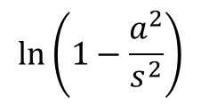
Homework problems
1. Find the Laplace Transform for the following
2. Find the Inverse Laplace Transform for the following
$$\ln\left(1−\frac{a^{2}}{s^{2}}\right)$$

Slide 11


